Slide 1
Delice Ishimwe
Web Tech Summer 2024 Final Exams

Slide 2
Delice Ishimwe is developing Npontu InsightHub, a data powered website to help businesses like Npontu Technologies efficiently gather and manage customer feedback. The platform solves the problem of disorganized feedback collection and lack of actionable insights by providing an intuitive interface for customers to submit feedback and a real time dashboard for administrators to analyze trends, categorize issues and make informed decisions.

Slide 3
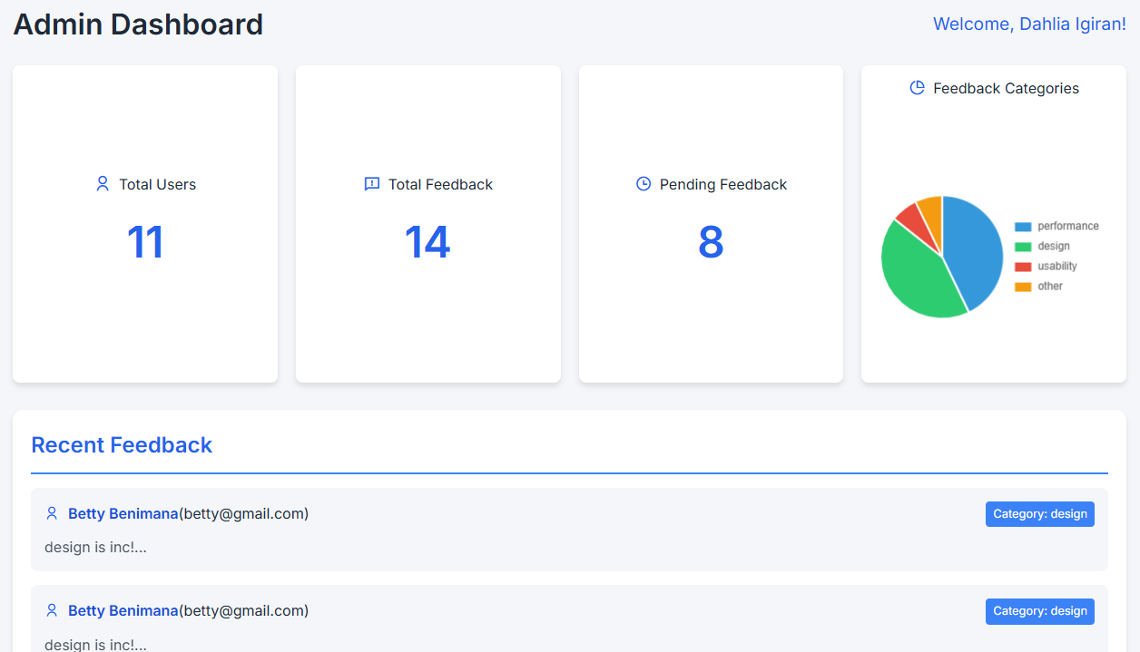
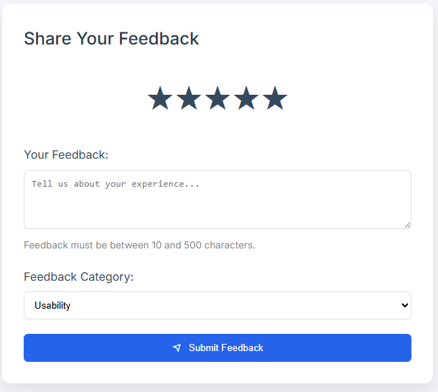
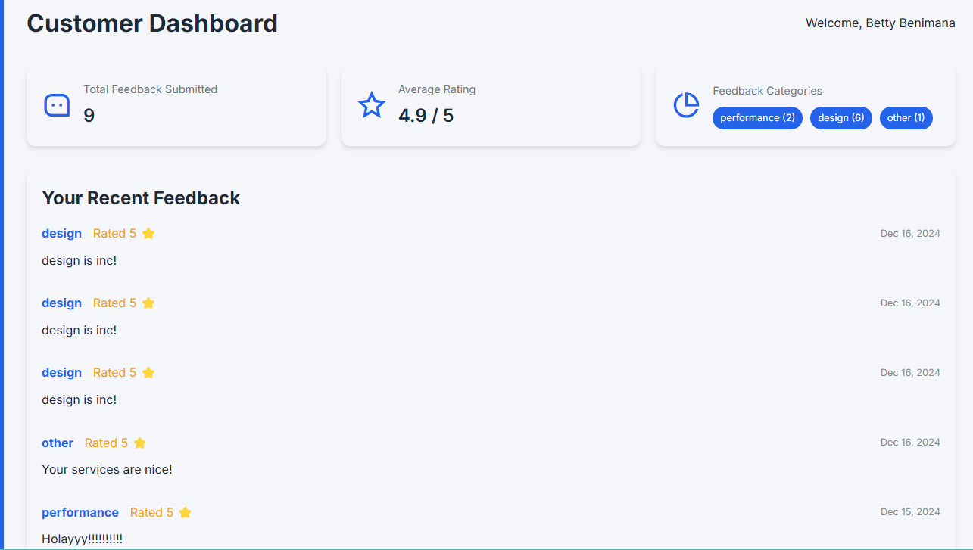
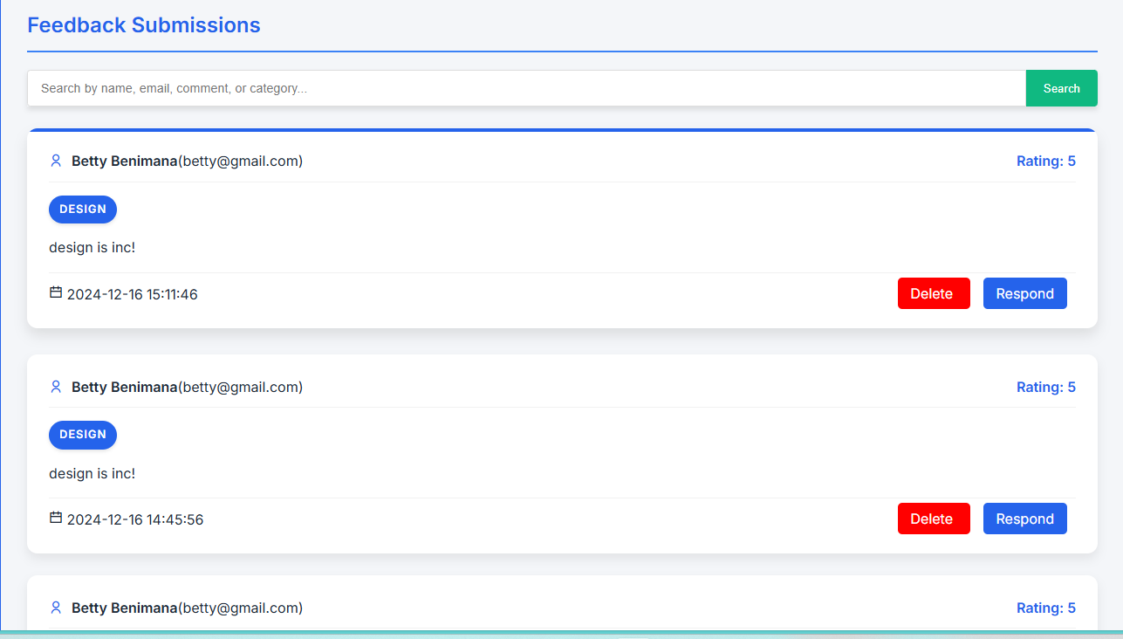
Npontu InsightHub
ddd
The website will solve the problem of inefficient feedback collection and management by providing a centralized platform for customers to share their experiences and for administrators to analyze and act on feedback in real-time.
This Admin dashboard provides a comprehensive overview, showing total users, total ratings, total feedback, pending feedback with a cart highlighting the most pressing feedback categories, helping prioritize customer concerns for timely action.
Users are better off with the website as it streamlines feedback collection and analysis, enabling faster identification of issues, up-to-date insights, and more efficient decision-making, leading to improved products and services.
The website is used by customers, who are individuals or businesses with varying tech expertise, to submit feedback, and administrators, who are support staff, to manage and analyze the feedback for improvements.

Slide 4
User / Customer
The users of this website are customers and administrators.
Customers: Individuals or businesses who use the platform to provide feedback on products and services, sharing their experiences to help improve offerings.
Administrators: Support staff who manage and analyze the feedback submitted by customers, track trends, and take action based on the insights to enhance customer satisfaction and service quality.
The website serves Npontu Technologies, a Ghana-based company specializing in Big Data analytics, AI solutions, software and app development, and IT consulting. Its purpose is to gather actionable feedback to continuously improve its products and services.

Slide 5
Main Functions of the Website
Feedback Submission: Customers can submit feedback via a simple form with ratings and comments, categorized by type (e.g., usability, performance).
Admin Dashboard: Administrators can view and analyze feedback trends, key metrics, and flagged issues to prioritize actions.
Feedback Management & Response: Admins can filter, view, edit, delete feedback, and track the status of pending issues to ensure timely responses. They can also respond to feedback, allowing customers to receive updates on the resolution of their concerns.
User Management: Admins can edit, delete, approve, or add new users, ensuring proper access control and user management.

Slide 6
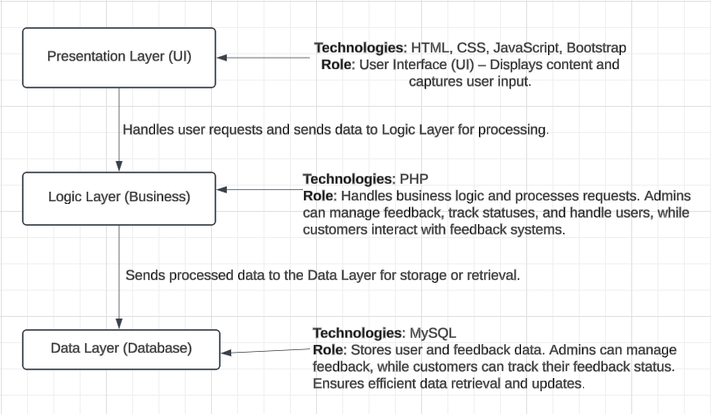
Architecture

